Slide 1
Sitecore Send SITECORE USER GROUP PPT Oct 11, 2021

Slide 2



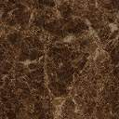
Sitecore Send Features
Pre-existing Email Templates
Personal Email Template Library
Design History
Personalized Email
Campaign Scheduling
Responsive design
Countdown timer
Ecommerce Integration
Drag and drop design
Custom Fonts
Send-a-Test
Add a Video
Image Picker
Integrate with FB / Insta / Dropbox etc.

Slide 3
References
https://moosend.com/

